Slide 1
INFORMATION RETREIVAL
UNIT 2 INTRODUCTION

Slide 2
TOPICS
Text Categorization and Filtering
Text Clustering for Information Retrieval
Web Information Retrieval
Learning to Rank
Link Analysis and its Role in IR Systems

Slide 3
CHAPTER 1:
Text Categorization and Filtering

Slide 4
Text Categorization & Filtering
Automatic process of assigning documents to predefined categories.
Example: Email → Spam / Not Spam

Slide 5
Text Classification
Task of predicting class labels for documents.
Example: News → Sports, Politics, Tech

Slide 6
Naive Bayes Classifier
Probabilistic classifier based on Bayes' Theorem with independence assumption.
Example: Spam detection

Slide 7
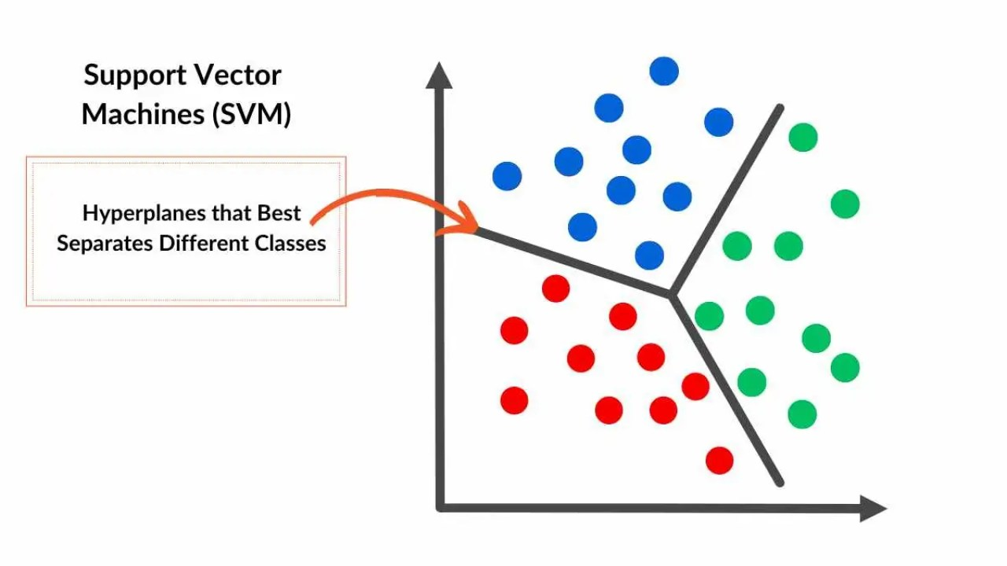
Support Vector Machine (SVM)
Supervised classifier that finds optimal separating hyperplane.
Example: Sentiment classification

Slide 8
Feature Selection
Selecting important terms for classification to improve performance.
Example: Removing stopwords

Slide 9
Dimensionality Reduction
Reducing number of features while preserving important information.
Example: PCA, LSA

Slide 10
Applications
Spam filtering, Document organization, Recommendation systems

Slide 11
CHAPTER 2:
Text Clustering for Information Retrieval

Slide 12
Text Clustering
Text clustering groups similar documents without using predefined labels.
Example: Grouping similar search results together.

Slide 13
K-Means Clustering
K-Means divides documents into K clusters based on similarity.
Example: Customer segmentation in marketing.

Slide 14
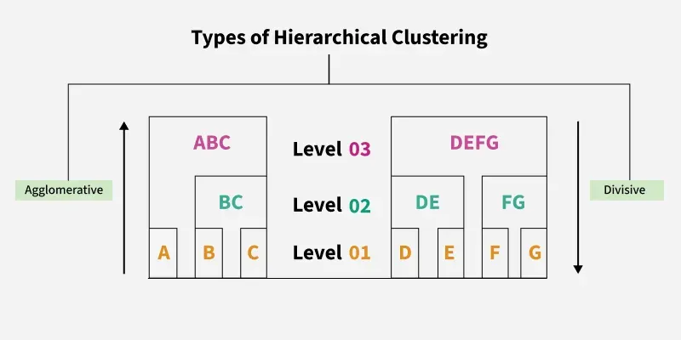
Hierarchical Clustering
Hierarchical clustering creates a tree structure of document clusters.
Example: Organizing research papers by topics and subtopics.

Slide 15
Evaluation of Clustering
Clustering evaluation measures how well documents are grouped.
Example: Purity, Silhouette Score.

Slide 16
Clustering for Query Expansion
Clustering helps improve search results by adding related terms to the query.
Example: Query: “car” → automobile, vehicle, engine.

Slide 17
CHAPTER 3:
Web Information Retrieval

Slide 18
Web Information Retrieval
Web IR retrieves information from the World Wide Web.
Example: Google Search.

Slide 19
Web Crawling
Crawling is the process of collecting web pages automatically.
Example: Googlebot visits and downloads web pages.

Slide 20
Web Indexing
Indexing organizes web pages for fast searching.
Example: Inverted index of web pages.

Slide 21
Web Search Challenges
Web IR faces many challenges due to the size and nature of the web.
Examples: Huge data volume, spam pages, duplicate pages.

Slide 22
PageRank Algorithm
PageRank ranks web pages based on the number and quality of incoming links.
Example: Popular pages appear higher in Google results.

Slide 23
CHAPTER 4:
Learning to Rank

Slide 24
Learning to Rank
Learning to Rank uses machine learning to arrange search results in the best order.
Example: Google improving results using user clicks.

Slide 25
RankSVM
RankSVM learns ranking functions using support vector machines.
Example: Ranking documents for a search query.

Slide 26
RankBoost
RankBoost is a boosting-based algorithm for ranking.
Example: Combining weak rankers to improve ranking accuracy.

Slide 27
Pairwise vs Listwise Ranking
Pairwise compares document pairs, Listwise ranks the entire list at once.
Example: Choosing which of two results is better vs ordering all results.

Slide 28
Evaluation Metrics for Ranking
Ranking evaluation measures how good the result order is.
Examples: MAP, NDCG, Precision@K.

Slide 29
CHAPTER 5:
Link Analysis and its Role in IR

Slide 30
Link Analysis
Link analysis studies web links to determine page importance.
Example: Using links to improve search ranking.

Slide 31
Web Graph Representation
The web is represented as a graph of pages (nodes) and links (edges).
Example: Page A → Page B means A links to B.

Slide 32
HITS Algorithm
HITS identifies authority pages and hub pages.
Example: Wikipedia = authority, directory sites = hubs.

Slide 33
Applications of Link Analysis
Link analysis improves many web-based systems.
Examples: Search engines, web mining, recommendation systems.

Slide 34
Thank You

